Slide 1


Assessment of neurotrophin-loaded cryogel microcarriers for improving engraftment of human iPSC-derived dopaminergic progenitors
Saoirse Ryan
PhD Candidate
Supervisors: Prof Eilís Dowd & Dr Declan McKernan

Slide 2
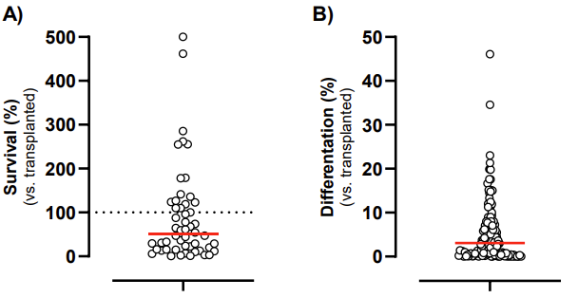
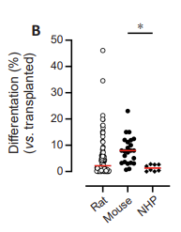
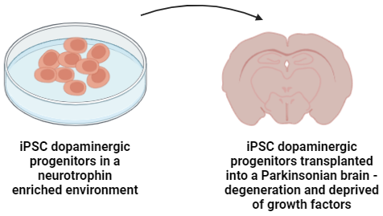
Cellular-based brain repair
Cellular based brain repair is a therapeutic option to treat Parkinson’s disease
Engraftment remains limited with poor survival and differentiation of iPSCs in situ in the brain
Cells are taken from their neurotrophin enriched environment
Median Survival ~51% but median differentiation ~3%
Poor differentiation in various species
(Jarrin et al., 2021)
(Comini and Dowd 2024)

Slide 3
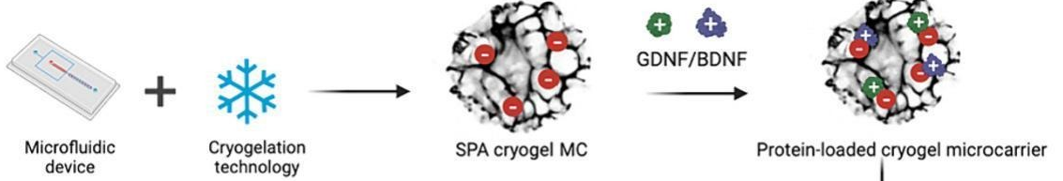

Cryogel Microcarriers
Negatively charged cryogel microcarriers -> 3-sulfopropyl acrylate (SPA) and poly (ethylene glycol) diacrylate (PEGDA)
GDNF and BDNF could be loaded to the microcarriers and released in a controlled manner over weeks and months
Increase the retention of neurotrophins
Sustained release of neurotrophins
Help cell survival and reinnervation
Microcarriers can potentially aid with engraftment of iPSC-DAPs
(Hakami et al 2024)
(Narasimhan et al 2024)

Slide 4
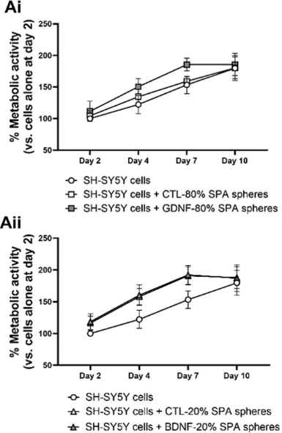
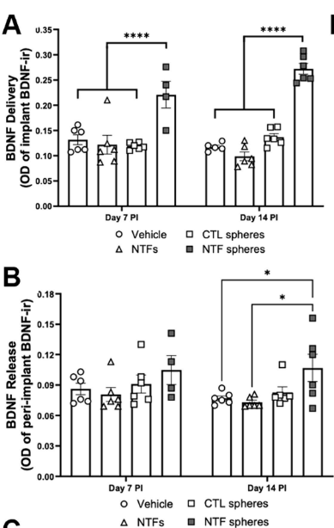
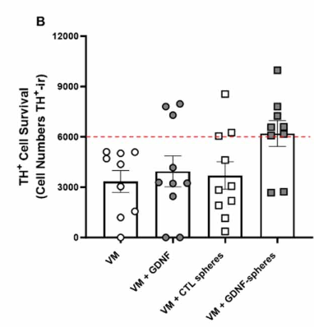
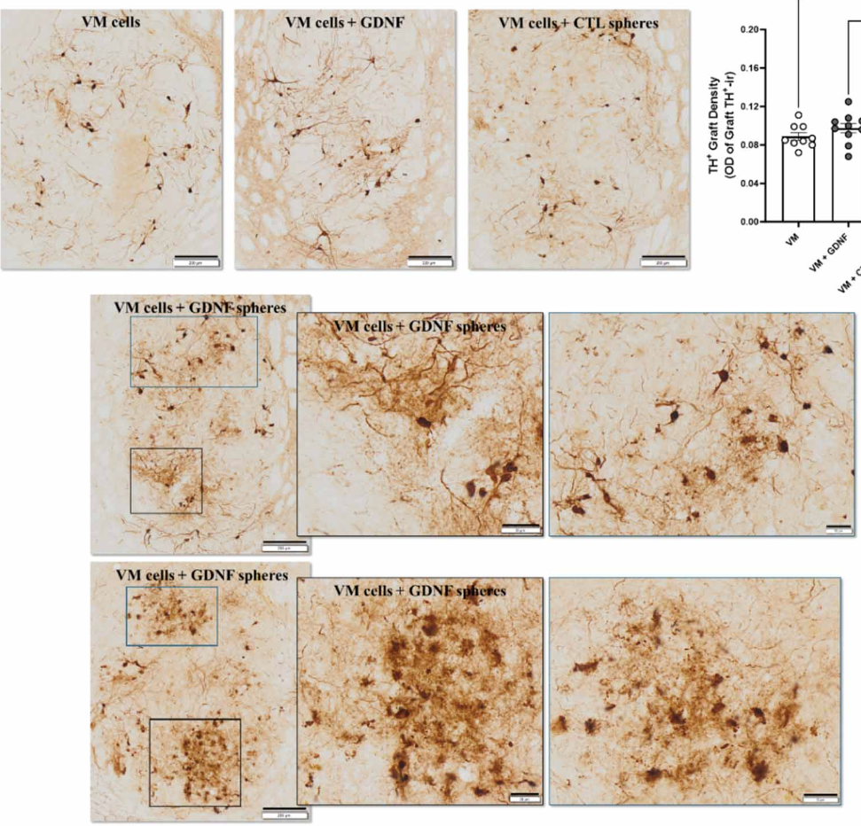
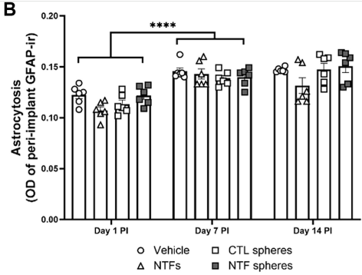
Cryogel Microcarriers
Cytocompatibility
Biocompatibility
Functionality
Survival of dopaminergic neurons
TH+ fibre sprouting
Rationale for using microcarriers -> They can deliver neurotrophins to the cells so that the cells aren’t deprived in the diseased environment
(Hakami et al 2024)
(Narasimhan et al 2024)

Slide 5
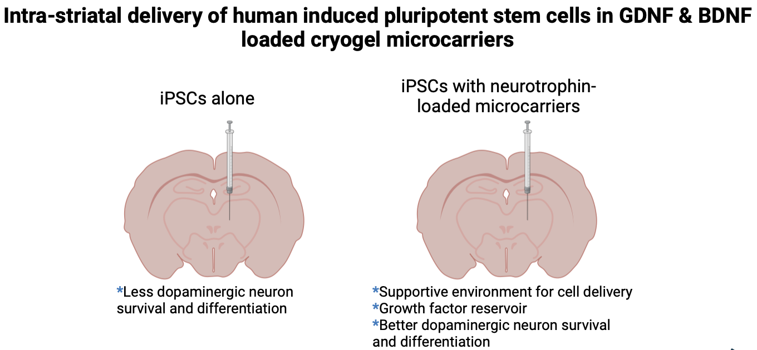
Aims and Hypothesis
Aim
Improve engraftment of iPSC-derived dopaminergic progenitors (iPSC-DAPs)
Phase 1
Determine if microcarriers are cytocompatible with iPSC-DAPs
Hypothesis: Microcarriers are cytocompatible with iPSC-DAPs and therefore potentially could improve the survival and differentiation of iPSC-DAPs in situ in the brain

Slide 6
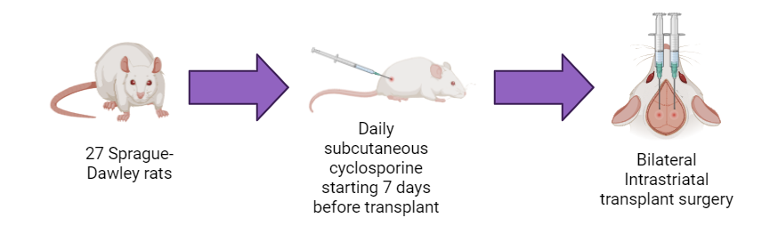


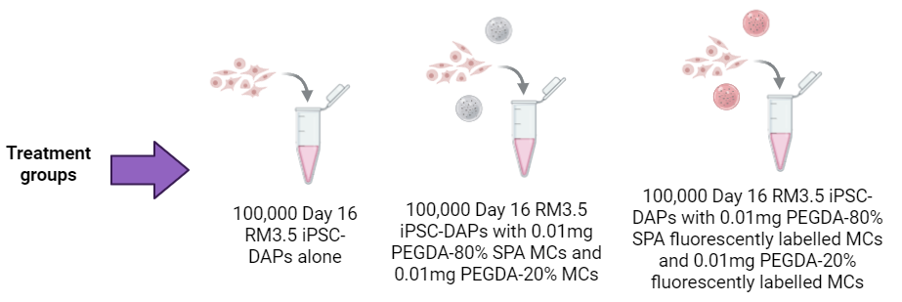

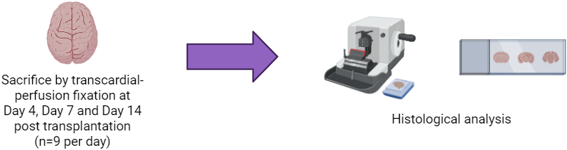

Methodology
iPSCs = Induced Pluripotent Stem Cells, SPA = 3-sulfopropyl acrylate, PEGDA = Poly (ethylene glycol) diacrylate

Slide 7

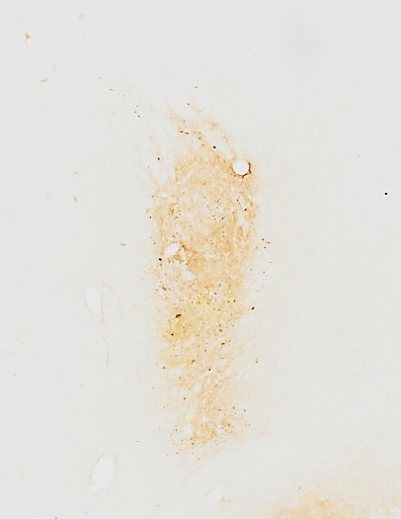
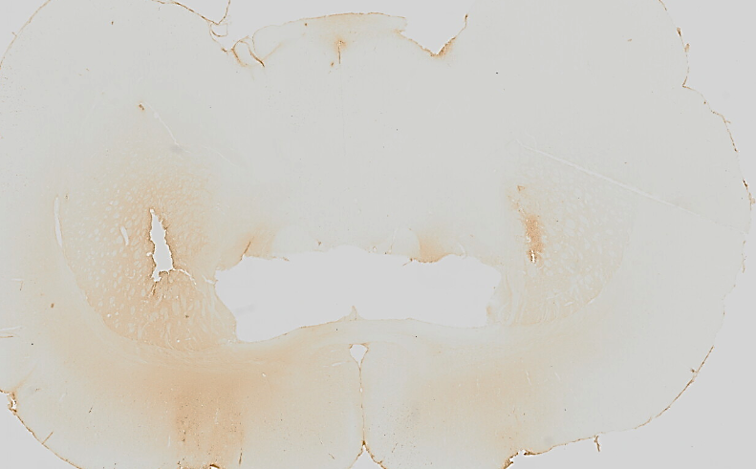
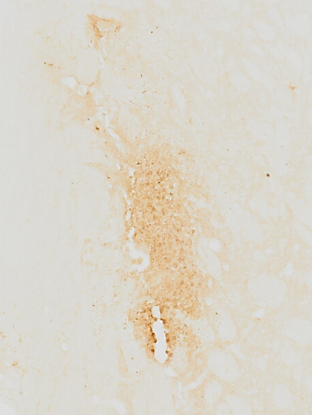
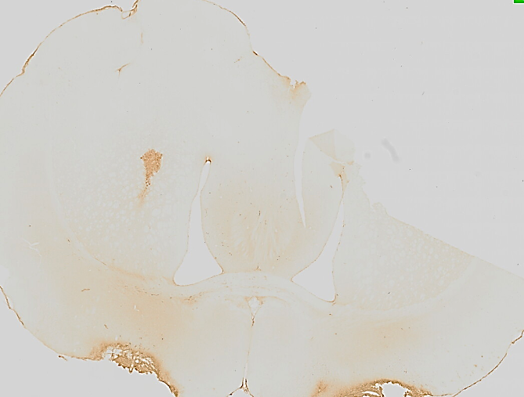
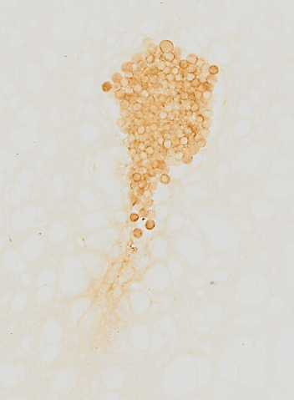
Results – Human Nuclei Staining – Cell Survival
Cells Alone
Cells & microcarriers
Group x Time F(4,43) = 0.523, p>0.05
Cells & tagged microcarriers
Group x Time F(4,43) = 1.427, p>0.05

Slide 8
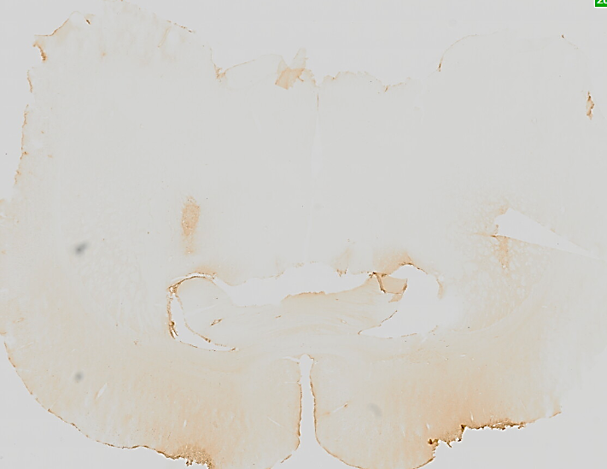
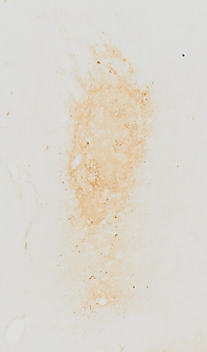
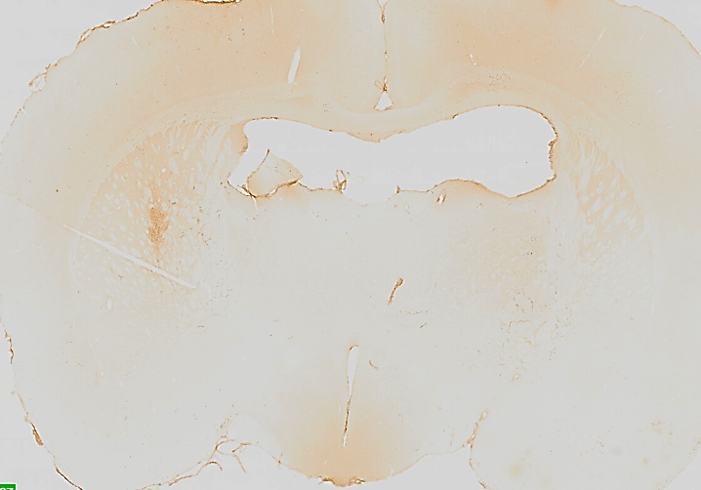
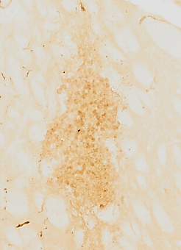
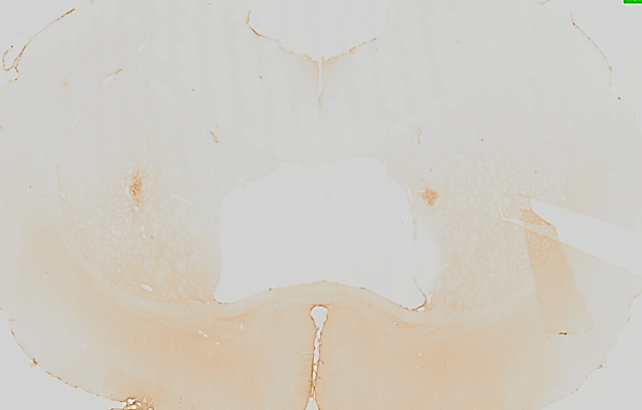
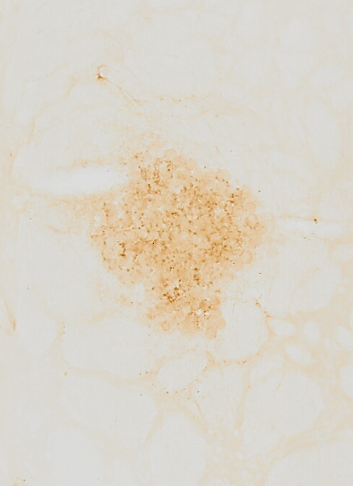
Results – STEM121 Staining – Cell Survival
Cells Alone
Cells & microcarriers
Group x Time F(4,43) = 1.691, p>0.05
Cells & tagged microcarriers
Group x Time F(4,43) = 1.162, p>0.05

Slide 9
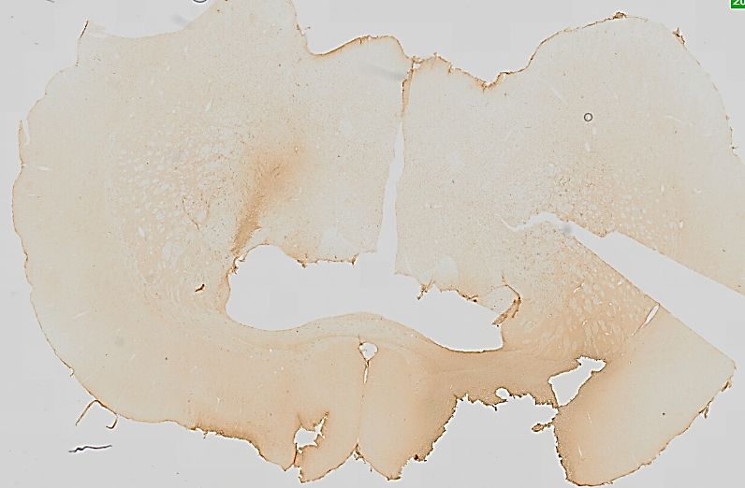
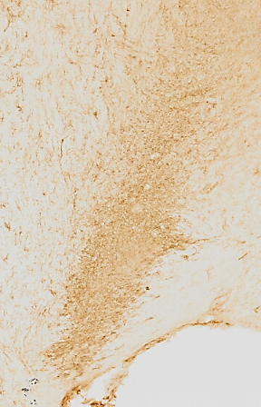
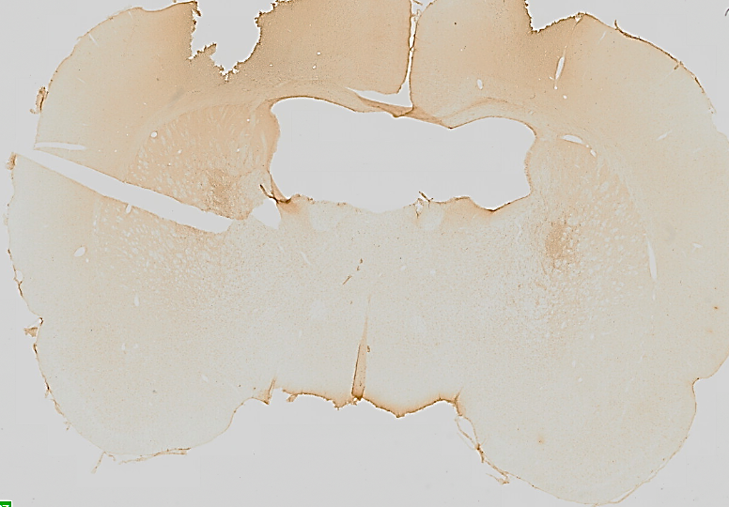
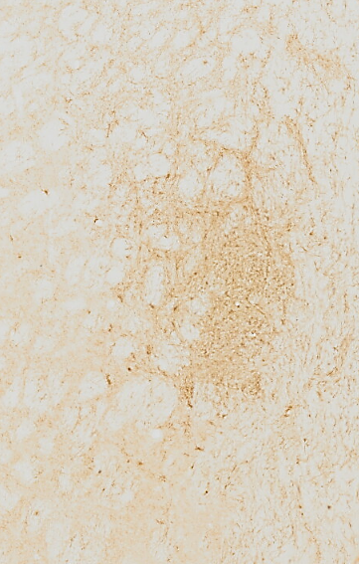
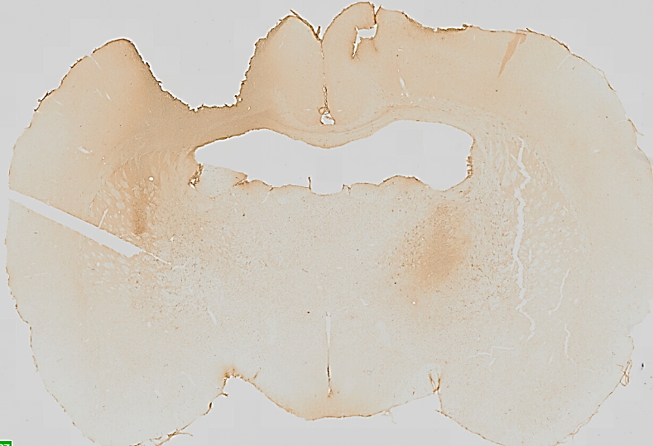
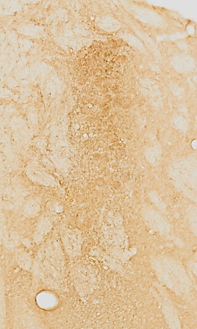
Results – OX42 Staining – Microgliosis
Cells Alone
Cells & microcarriers
Group x Time F(4,43) = 0.5417, p>0.05
Cells & tagged microcarriers
Group x Time F(4,43) = 1.330, p>0.05

Slide 10
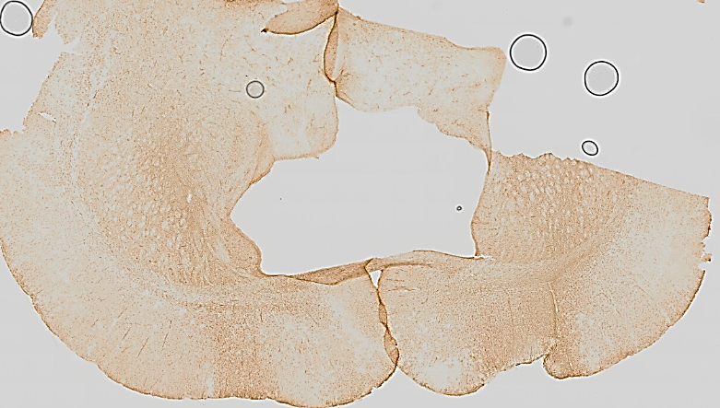
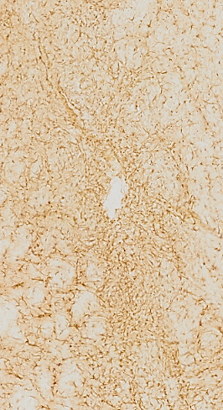
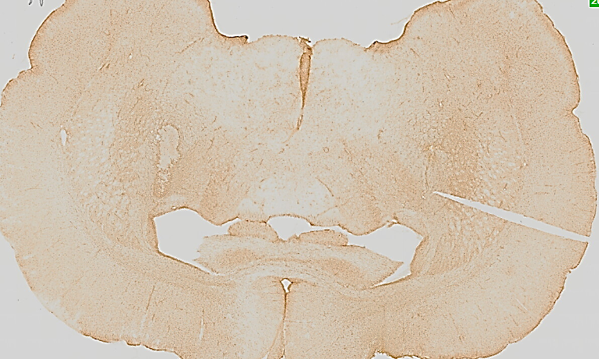
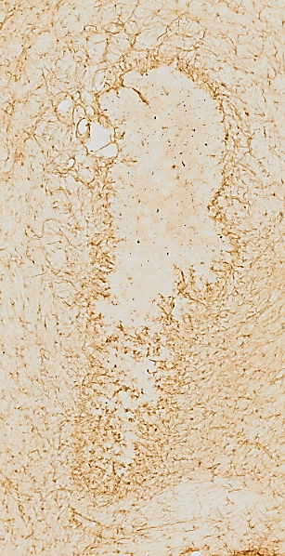
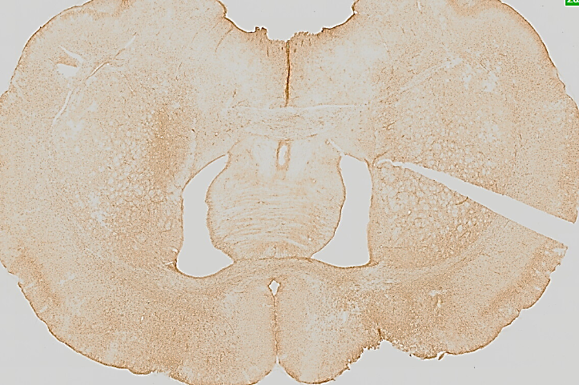
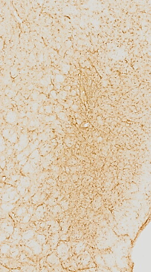
Results – GFAP Staining – Astrocytosis
Cells Alone
Cells & microcarriers
Group x Time F(4,43) = 0.1842, p>0.05
Cells & tagged microcarriers
Group x Time F(4,43) = 0.3293, p>0.05

Slide 11
Results – Fluorescence
Immunocytochemistry
Immunofluorescence
DAPI
TH
OTX2
FOXA2
Tagged Microcarriers
HuNu
DAPI
DAPI

Slide 12



Discussion and Conclusion
The microcarriers did not affect cell survival (Human Nuclei and Stem121 staining), microgliosis (OX42 staining) or astrocytosis (GFAP staining) when compared to cells alone. The microcarriers are cytocompatible and biocompatible.
The fluorescently tagged microcarriers remained successfully labelled in vivo and the RM3.5 iPSC-DAPs showed promising differentiation patterns in vitro.
Further studies should focus on testing the neurotrophin-loaded microcarriers with RM3.5 iPSC-DAPs to evaluate their potential and investigate if the microcarriers can enhance cell survival and differentiation.

Slide 13
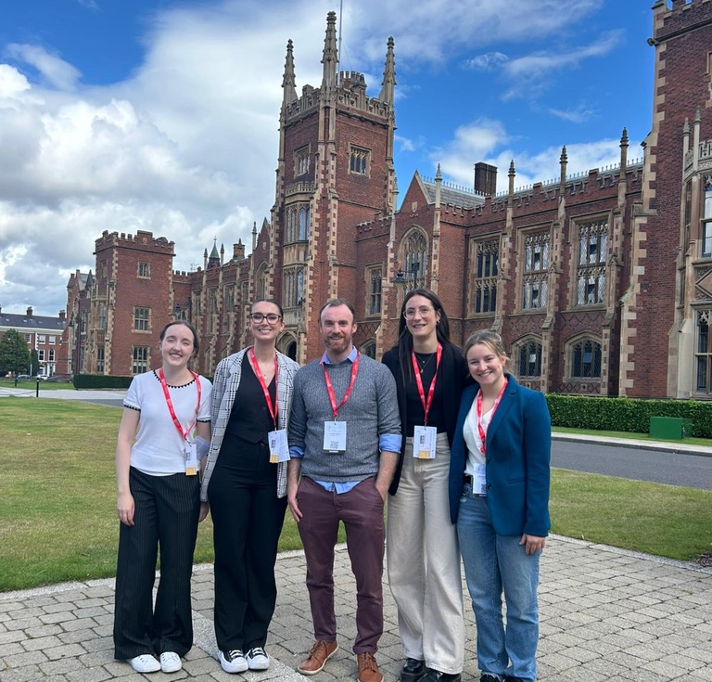
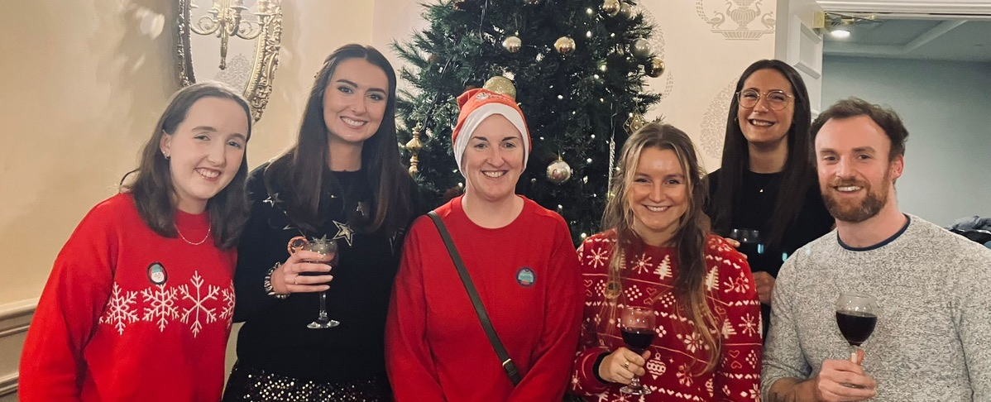




Acknowledgments
University of Galway
Prof Eilís Dowd
Dr Declan McKernan
Dr Giulia Comini
Ms Sarah Crudden
Mr Tommy Patton
Ms Sienna Stucke
Ms Robyn Gaffey
The University of Edinburgh
Prof Tilo Kunath
Dr Nicola Drummond
Ms Michela Barbato
The Florey Institute, The University of Melbourne
Prof Clare Parish
Dr Niamh Moriarty
Funding
Research Ireland - GOIPG/2023/3047
Cardiff University
Dr Ben Newland
Dr Abrar Hakami
Dr Sophie Hill

Slide 14
References
Comini G, Dowd E. A systematic review of progenitor survival and maturation in Parkinsonian models. Neural Regen Res. 2024 Nov 13. doi: 10.4103/NRR.NRR-D-24-00894. Epub ahead of print. PMID: 39589166.
Comini, G., & Dowd, E. (2025). The loaded matrix: neurotrophin-enriched hydrogels for stem cell brain repair in Parkinson's disease. Neural regeneration research, 20(8), 2315–2316.
Hakami A, Narasimhan K, Comini G, Thiele J, Werner C, Dowd E, Newland B. Cryogel microcarriers for sustained local delivery of growth factors to the brain. J Control Release. 2024 May;369:404-419.
JARRIN, S., CABRÉ, S. & DOWD, E. 2021. The potential of biomaterials for central nervous system cellular repair. Neurochemistry International, 144, 104971.
Narasimhan, K., Hakami, A., Comini, G., Patton, T., Newland, B., & Dowd, E. (2024). Cryogel microcarriers loaded with glial cell line-derived neurotrophic factor enhance the engraftment of primary dopaminergic neurons in a rat model of Parkinson's disease. Journal of neural engineering, 21(5).

